Slide 1
BNU-BCC
Connor W, Mark F, Kevin K

Slide 2
Introduction
BCC is a tool used by students to rate their current teachers, view reviews of future teachers and contact previous students who have had those teachers

Slide 3
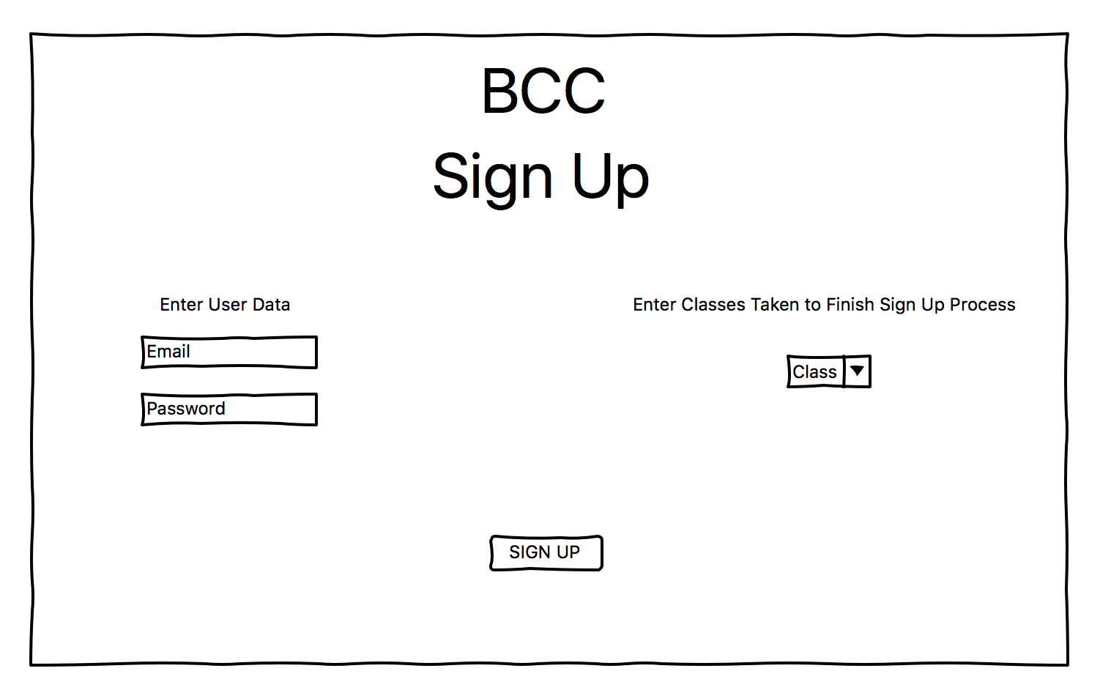
Wireframes

Slide 4
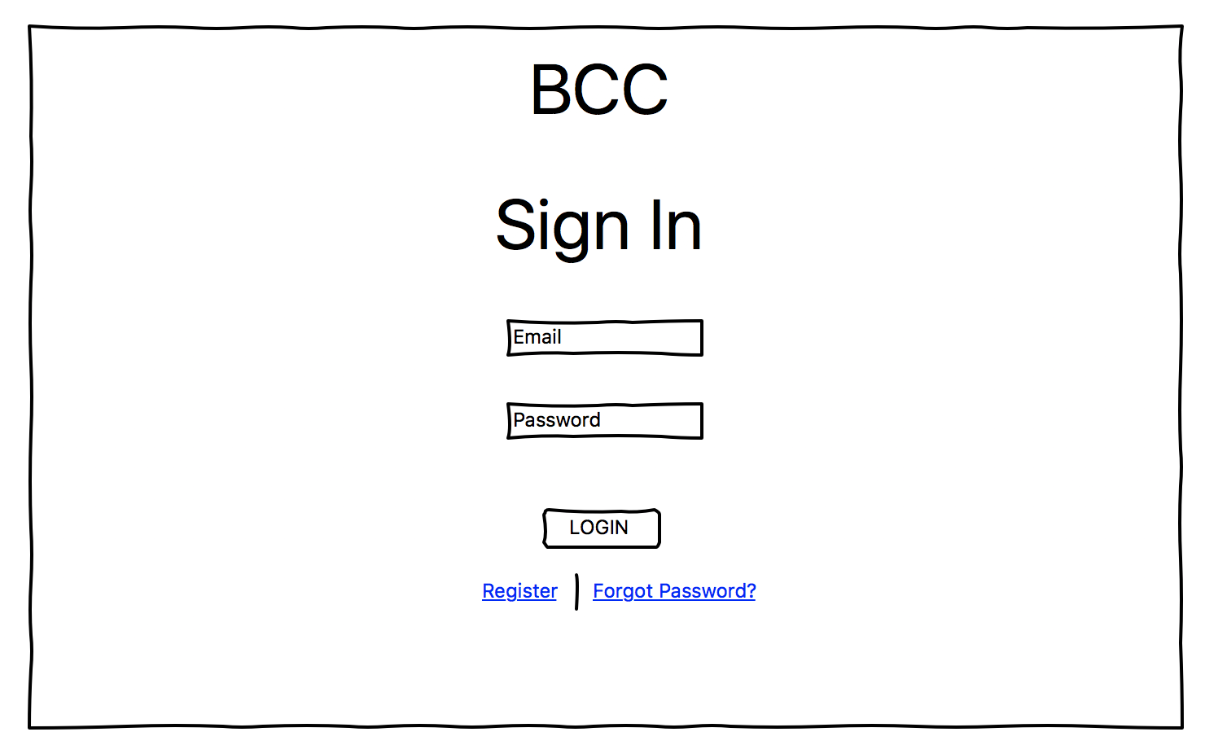
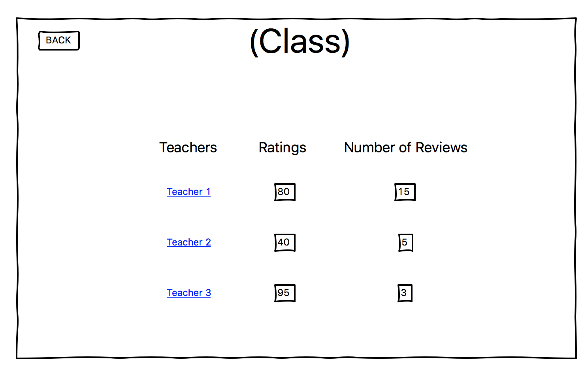
Wireframes
https://github.com/MarkFuller1/BNU/blob/master/docs/WireScreenShots/Screen%20Shot%202019-09-16%20at%209.29.44%20PM.png https://github.com/MarkFuller1/BNU/blob/master/docs/WireScreenShots/Screen%20Shot%202019-09-16%20at%209.29.44%20PM.png

Slide 5
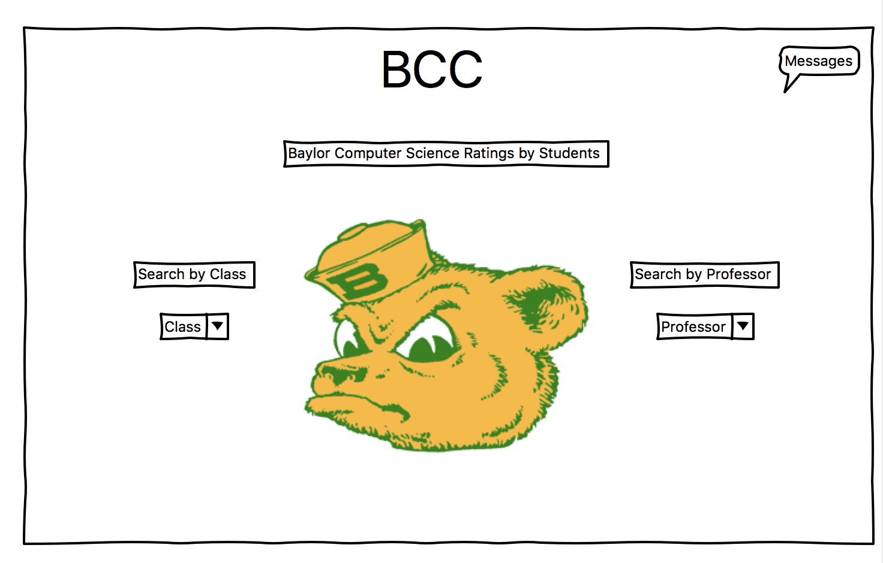
Wireframes

Slide 6
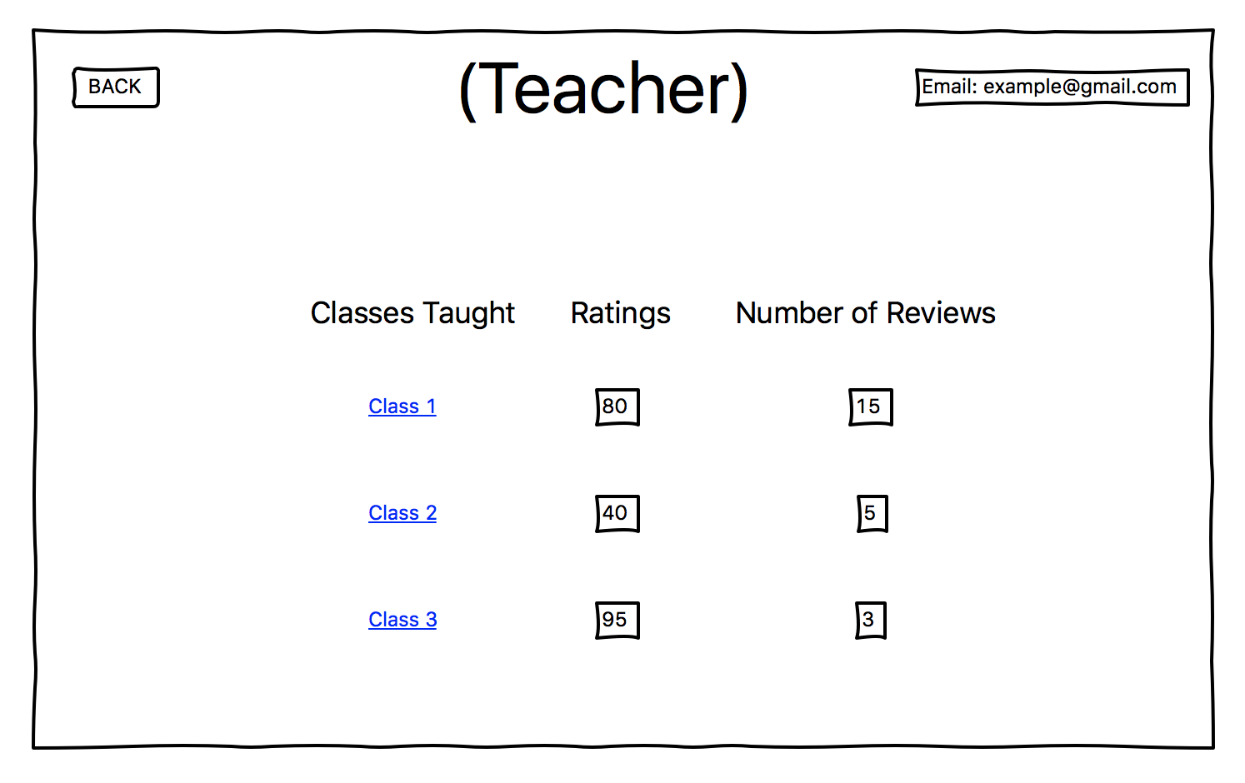
Wireframes

Slide 7
Wireframes

Slide 8
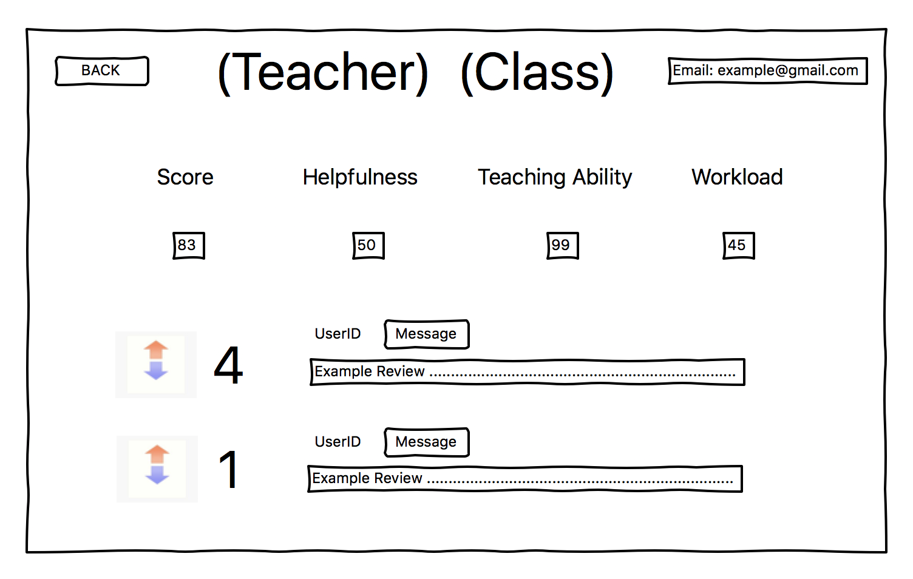
Wireframes

Slide 9
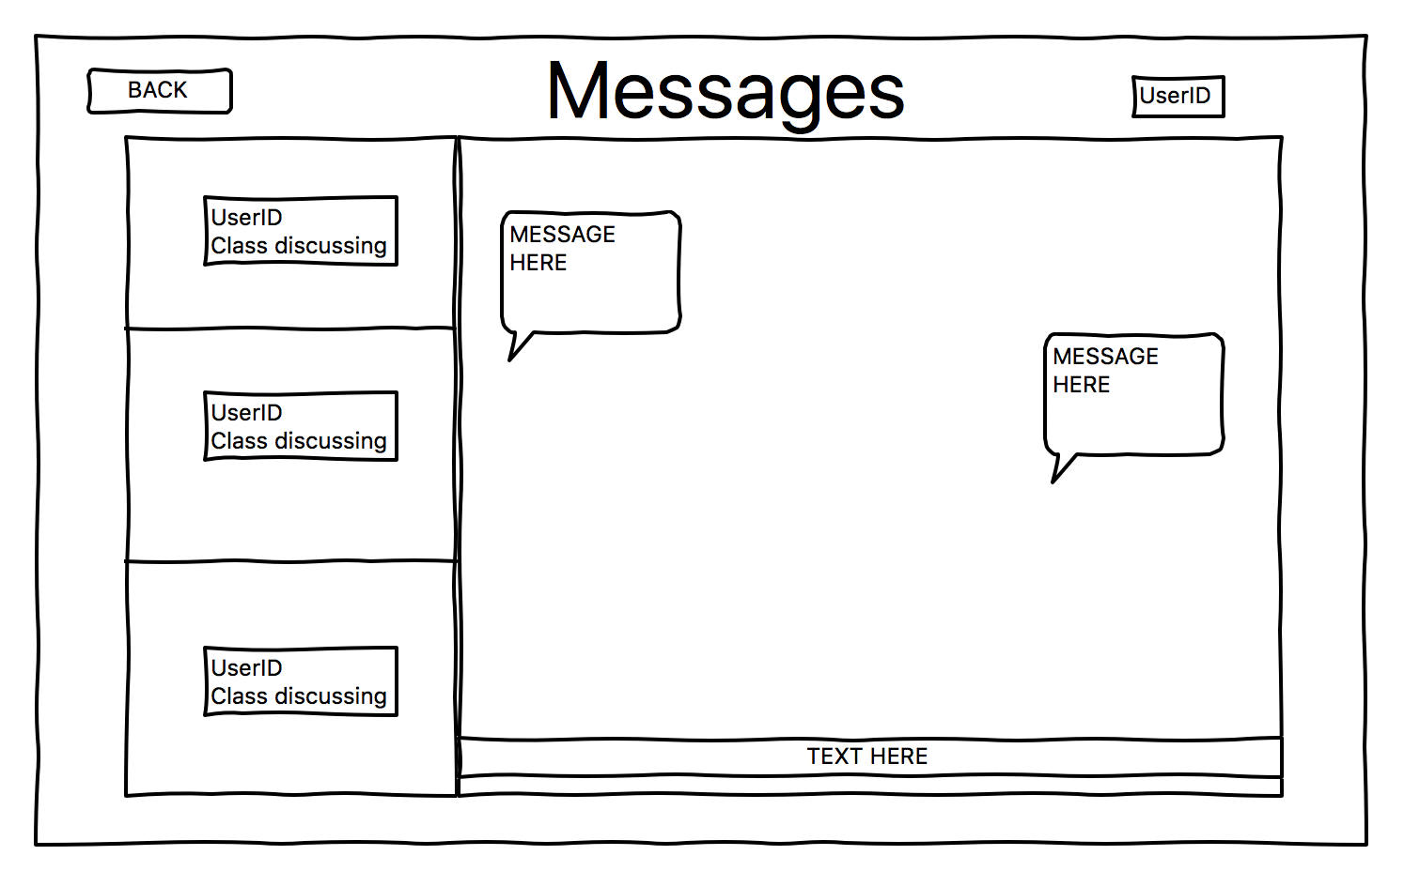
Wireframes

Slide 10
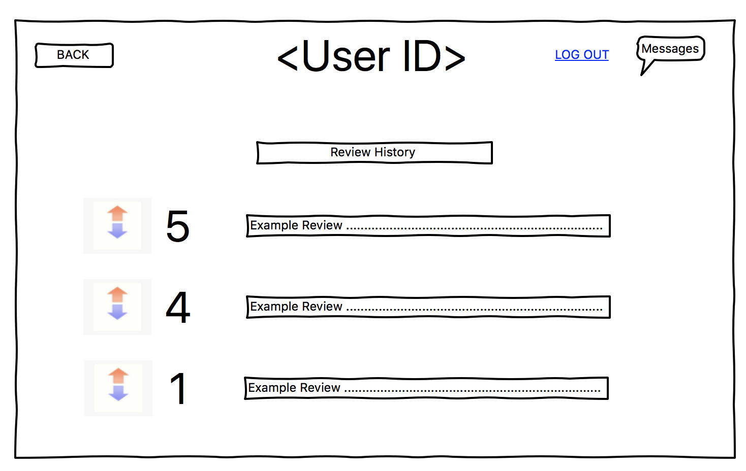
Wireframes

Slide 11
Requirements
Users need to be able to register an account.
Users must be able to search based on class.
Users must be able to see professor options after searching the class.
Users must be able to search based on professor.
Users must be able to write a review on a professor.
Users must be able to upvote or downvote a review.
Users must be able to send a message to the author of the review.
The reviewer must be able to respond to a message.
User must be able to log out.
The application must be able to sanitize user input.
User must be able to navigate bidirectionally in this application.
Users need to be able to delete an account.
Users must be able edit a review.

Slide 12
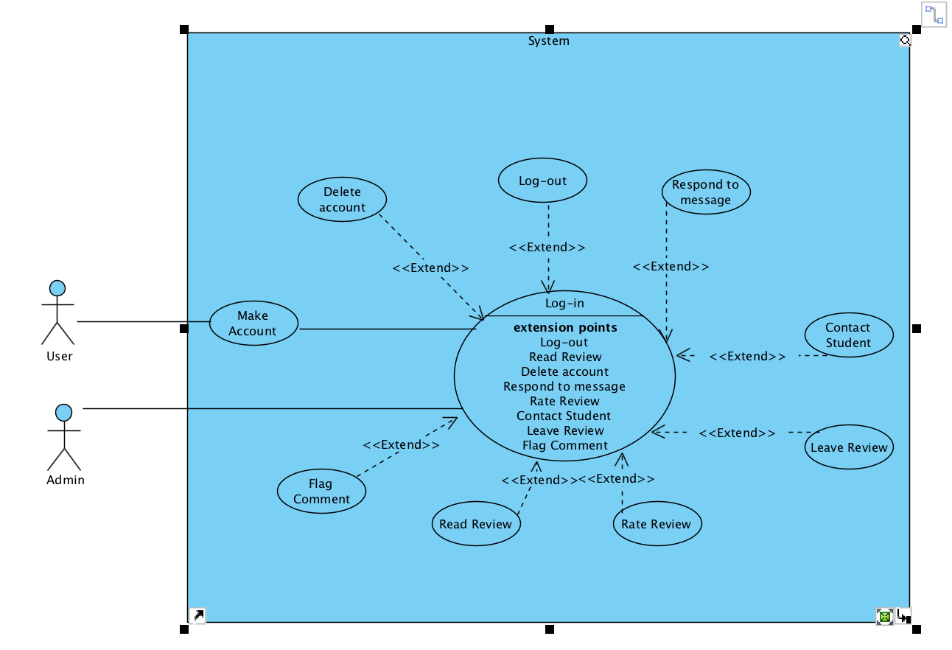
Use Case Diagram

Slide 13
Use Cases
https://github.com/MarkFuller1/BNU/wiki/Use_Case_List

Slide 14
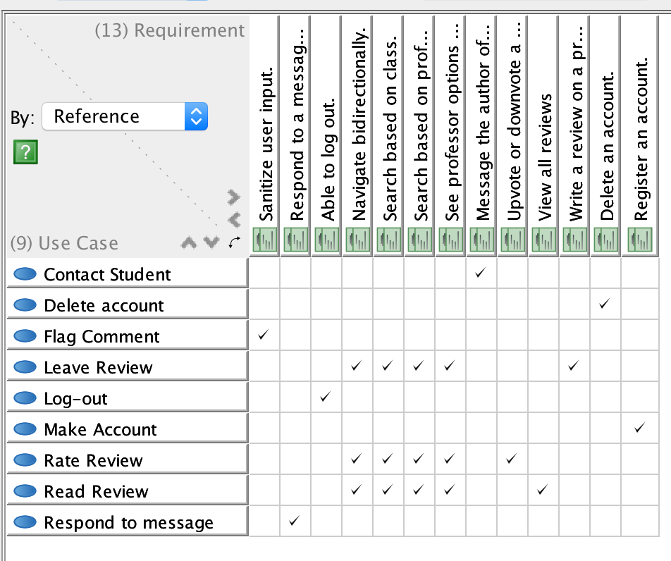
Traceability Matrix

Slide 15
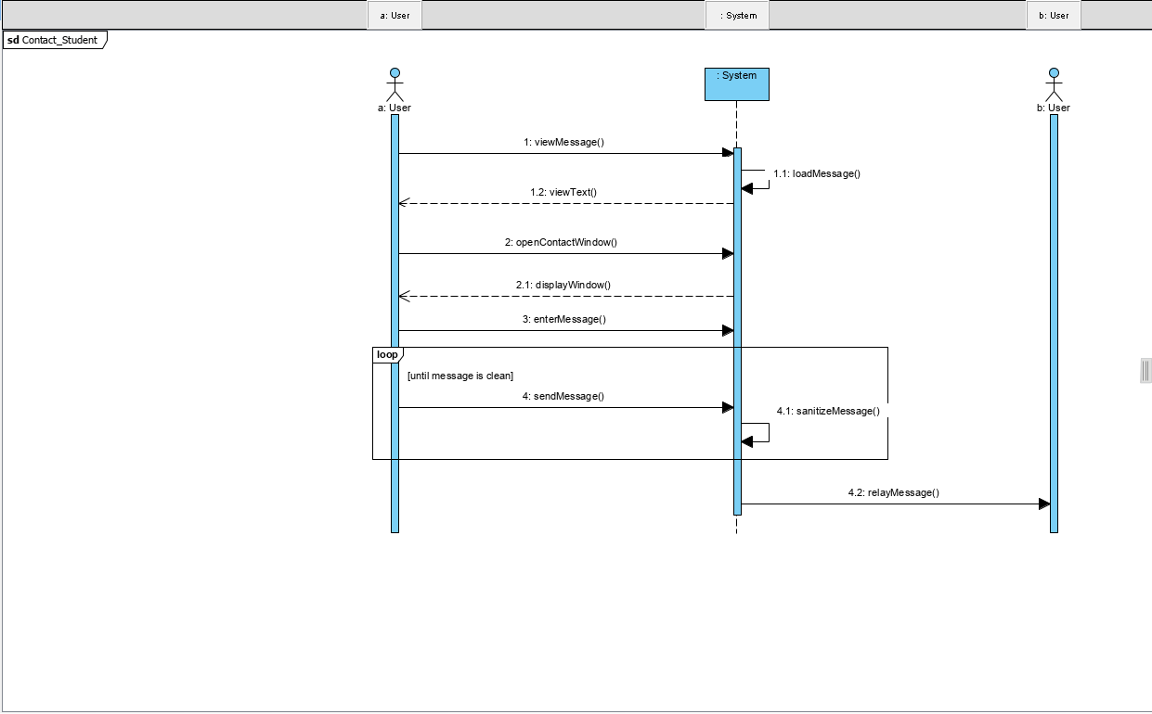
SSD

Slide 16
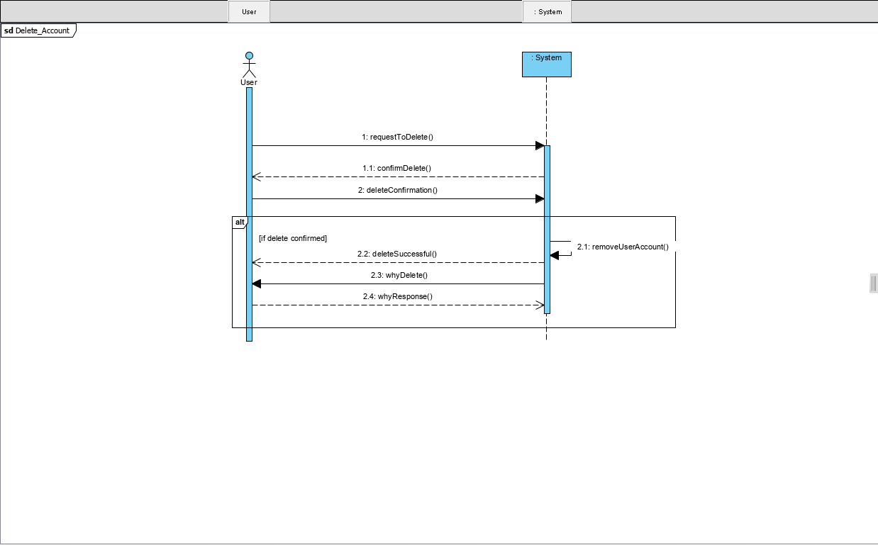
SSD

Slide 17
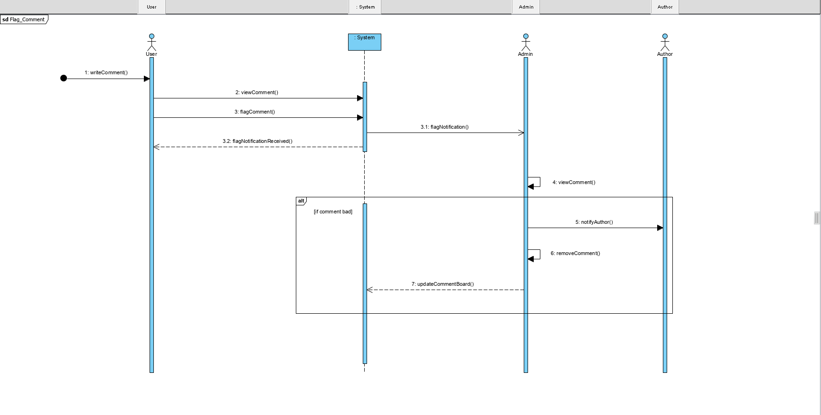
SSD

Slide 18
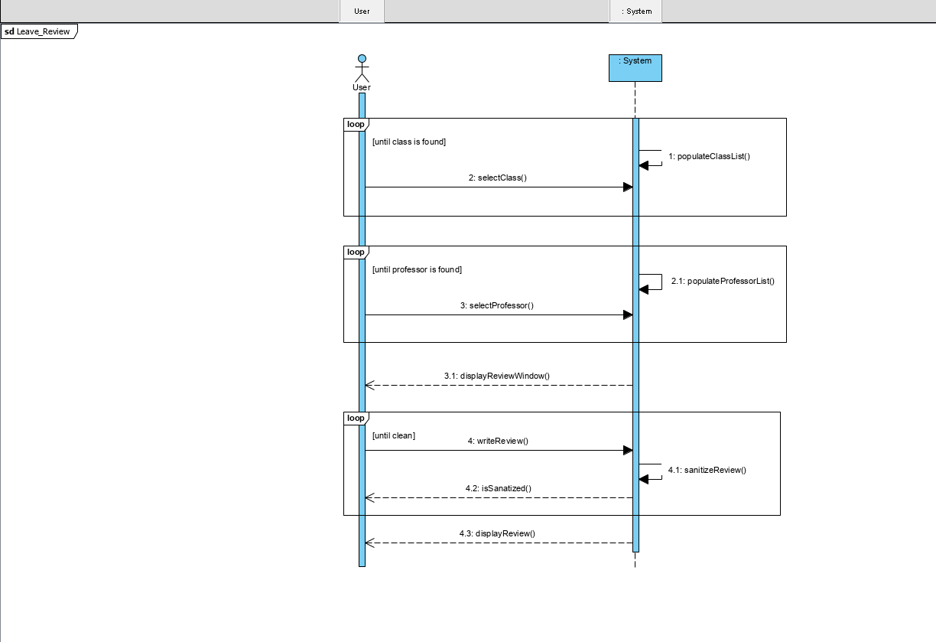
SSD

Slide 19
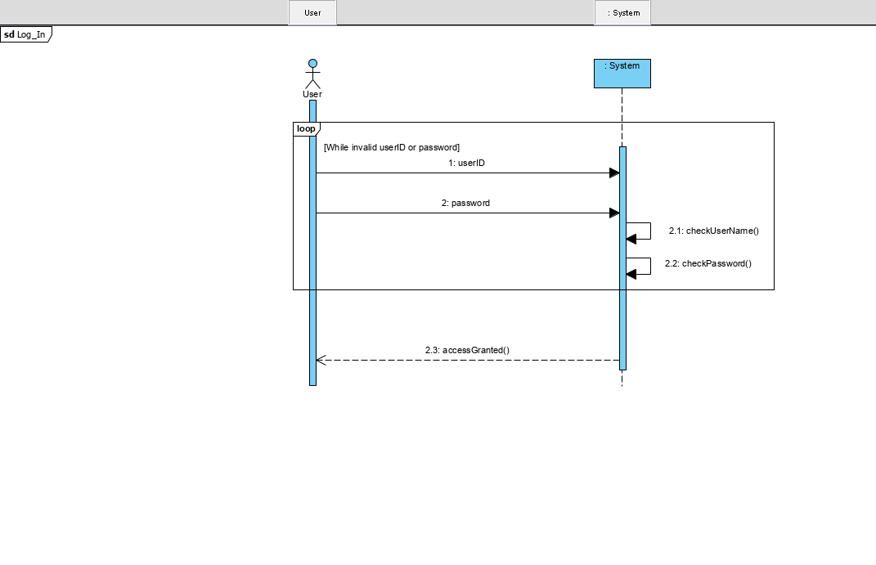
SSD

Slide 20
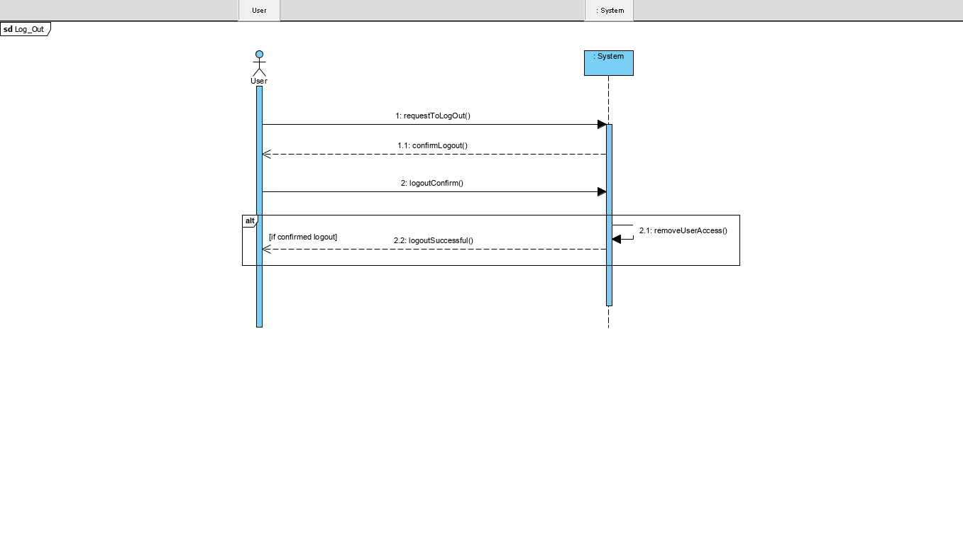
SSD

Slide 21
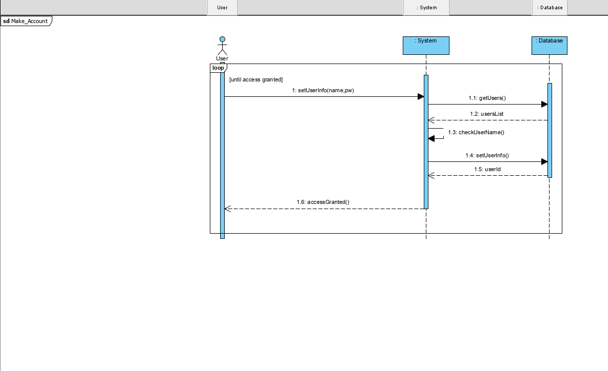
SSD

Slide 22
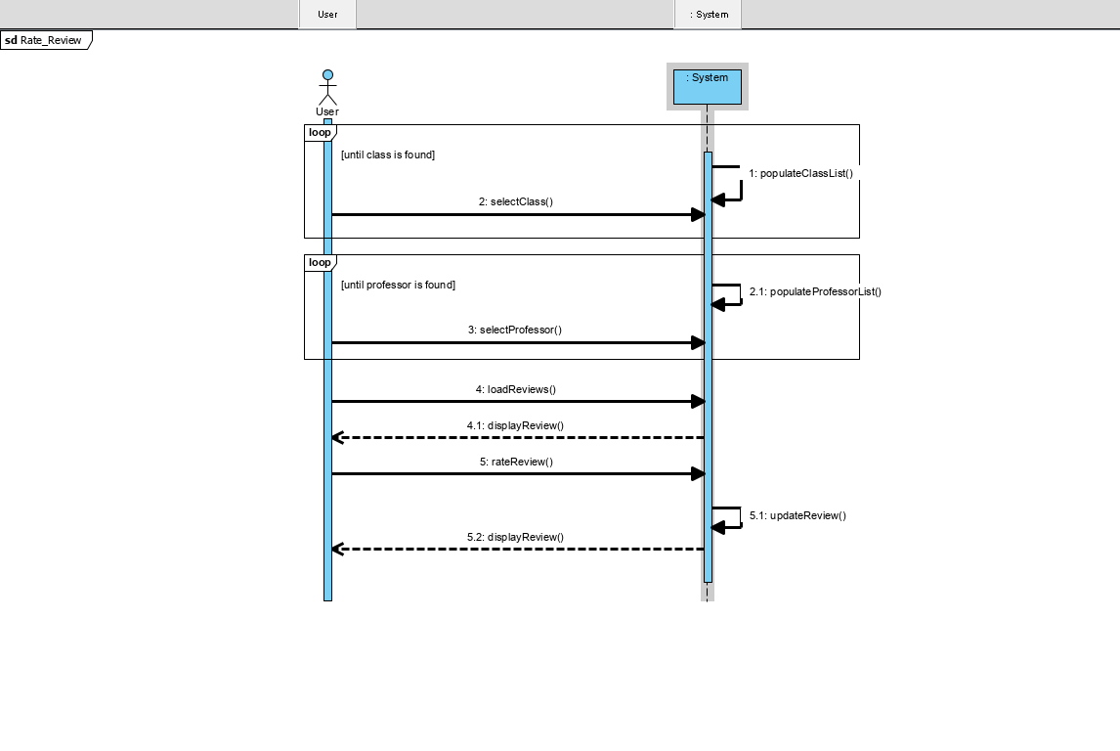
SSD

Slide 23
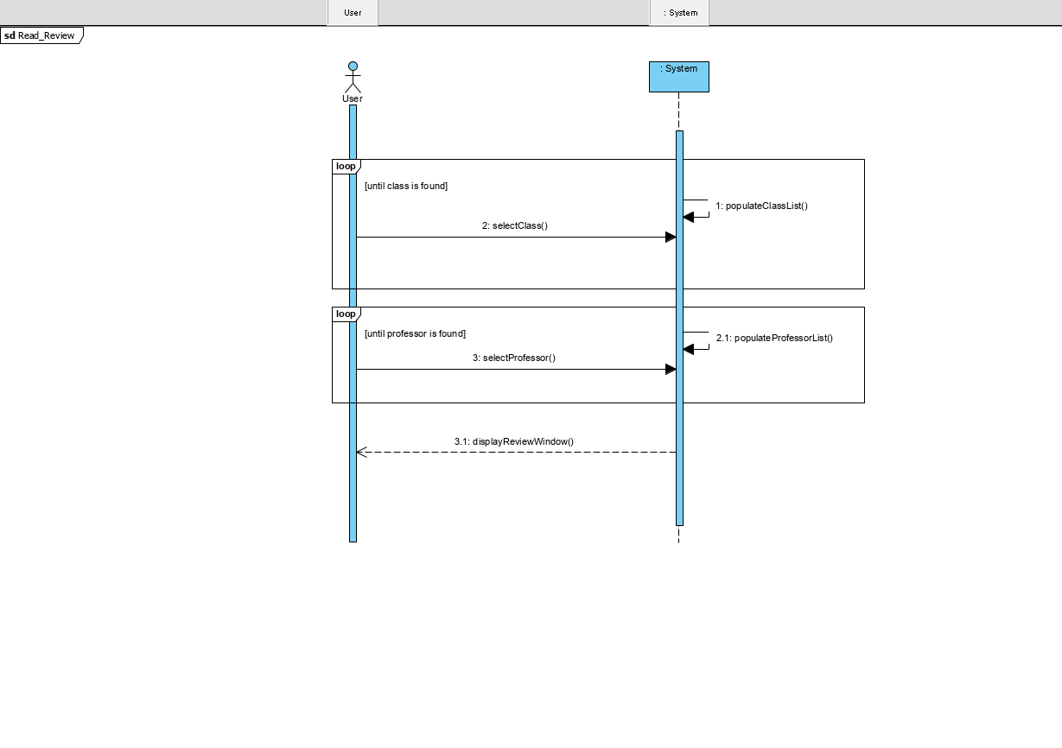
SSD

Slide 24
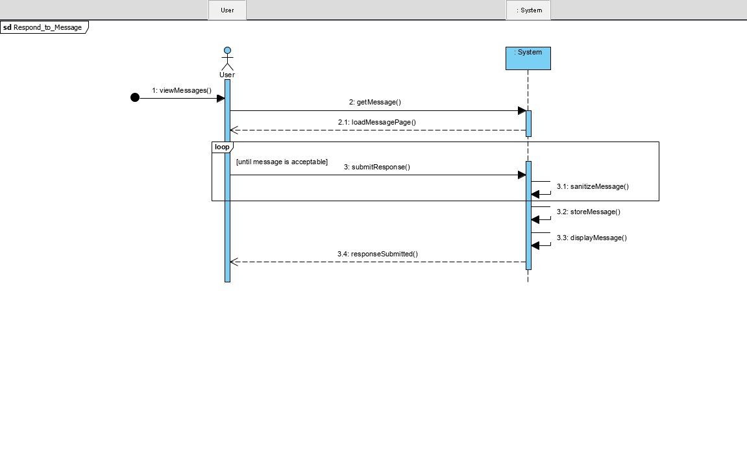
SSD

Slide 25
OPERATIONS
Examples
checkUsername()
checkPassword()
populateClassList()
populateProfessorList()
sendMessage()
viewMessage()
There are ~70 more ☺

Slide 26
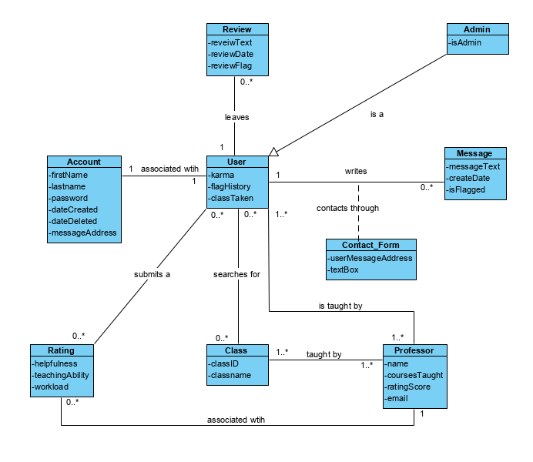
Domain MOdel

Slide 27
Questions?

